Slide 1

OS HEALTH MONITORING
Mariam Khorshid 211000746
Menna Kotb 211001861
Maryam Elabd 211001852
Ganna Aly 211001727
Mohamed hesham 211001466
Yousef alaa 211002053
01

Slide 2


Home
Video
About Us
Contact
In the world of computing, the operating system serves as the backbone of functionality and security. It encompasses aspects such as performance, security, stability, and user experience, crucial for seamless operation. A well-maintained operating system ensures optimal resource utilization, swift responsiveness to user inputs, and robust protection against security threats. Let's delve into the key components that contribute to the health of an operating system.
02

Slide 3
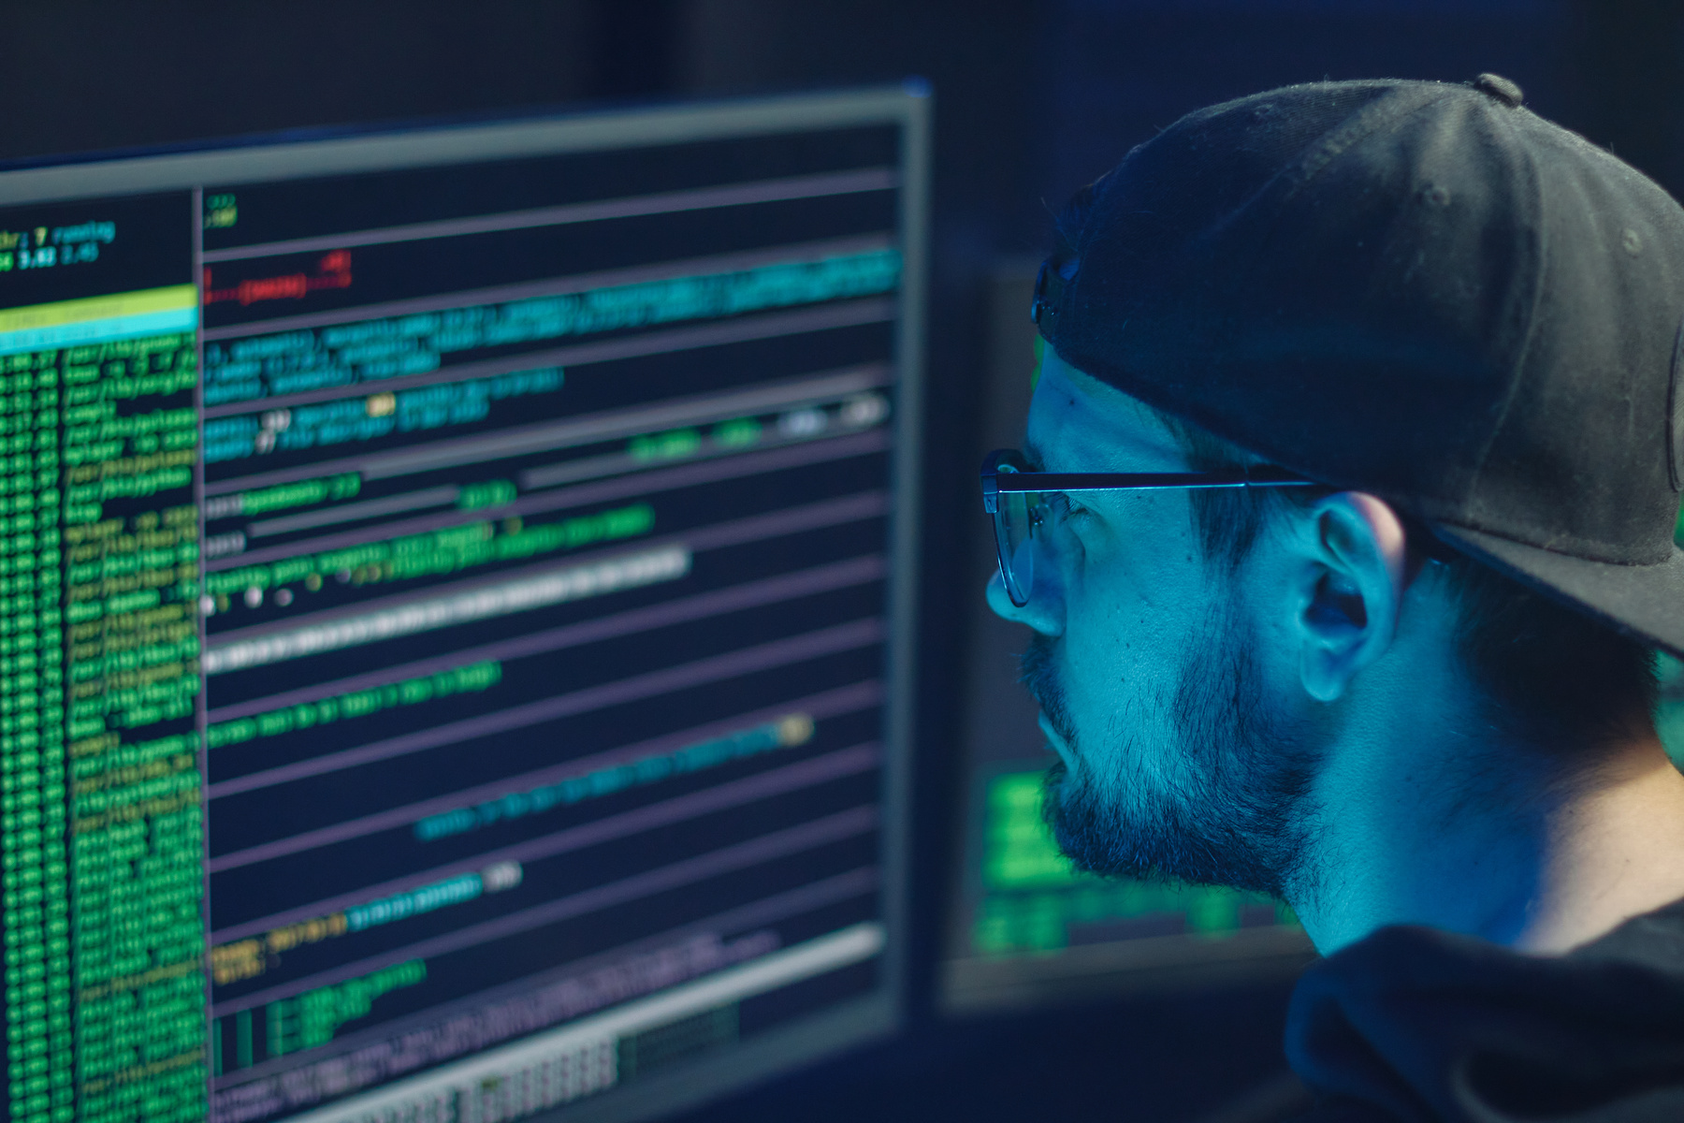
Studio Shodwe
Home
Video
About Us
Contact
OUR OBJECTIVES
objective 1
objective 6
Performance Monitoring: Keep track of system resources to ensure efficient operation and prevent bottlenecks.
Application Health Tracking: Monitor the health of applications to identify and address performance issues promptly, ensuring smooth operation.
objective 2
Security Enhancement: Implement mechanisms to safeguard against viruses and unauthorized access, enhancing system security.
objective 3
Stability Assurance: Ensure fault tolerance and reliability to prevent system crashes and ensure uninterrupted operation.
objective 4
User Experience Improvement: Develop a user-friendly interface and effective tools for troubleshooting, enhancing the overall user experience.
objective 5
Storage Capacity Monitoring: Monitor storage capacity to prevent data loss due to insufficient disk space and optimize storage usage.
03

Slide 4

Studio Shodwe
Home
Video
About Us
Contact
IMPLEMENATION
04

Slide 5
Studio Shodwe
Home
Video
About Us
Contact
RESULTS
04

Slide 6
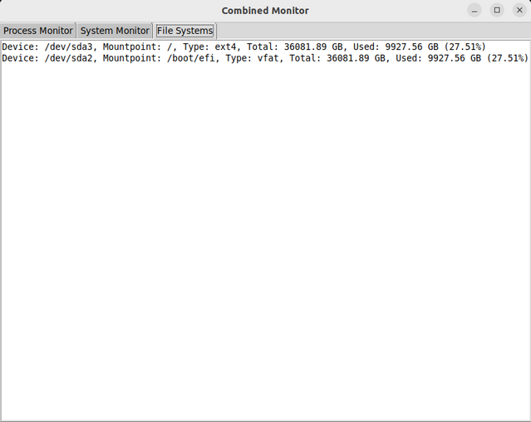
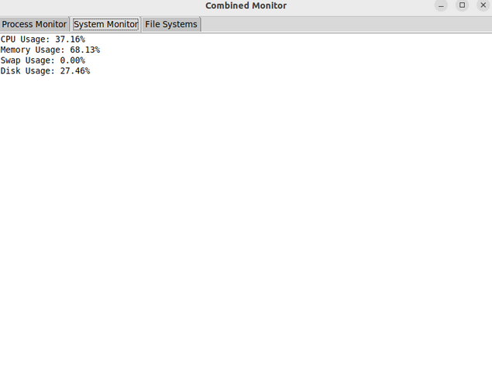
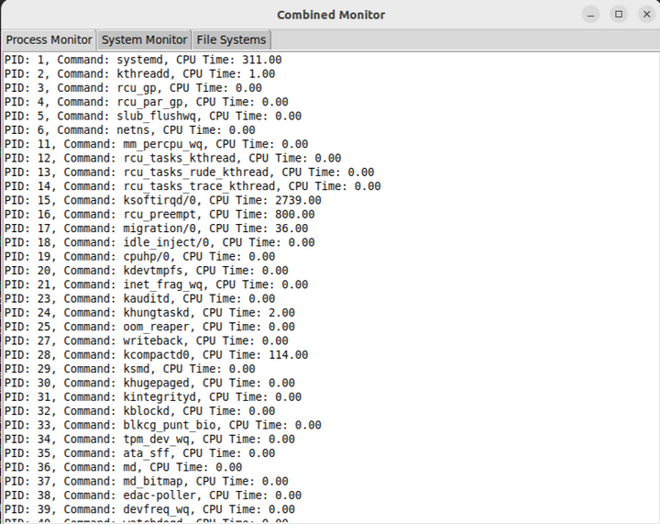
Studio Shodwe
Home
Video
About Us
Contact
05

Slide 7
LINK OF THE VIDEO

Slide 8
LINK OF THE REP

Slide 9
Studio Shodwe
Home
Video
About Us
Contact
THANK YOU
10

